Slide 1
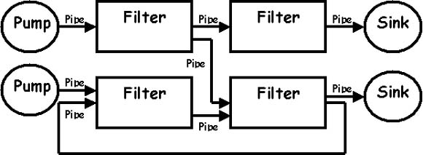
Pipe and Filter

Slide 2
The pipe and filter is an Architectural style which is made up of a stream of a data and flows in a stream through pipes and filters. In this pattern, there are many components, which are referred to as filters, and connectors between the filters that are called pipes. Each filter is responsible for applying a function to the given data; this is known as filtering. Filters can work asynchronously. The final output is given to the consumer, known as a sink.

Slide 3
The filters act as individual processes that can be run simultaneously and one filter does not control the operation of the others. This style is used for large projects that can be broken down into smaller individual processes.
This kind of style is used in some UNIX programs where the output of one program can be linked to the input of another program.
They are also used in compilers where the consecutive filters perform lexical analysis, parsing, semantic analysis and code generation to pass on to the pipe.

Slide 4
Advantages Of Pipe and Filter
Any changes can be made very easily to the software as we can always introduce new filters and steps
Simple: Allows easy understanding of the structure and functioning of the system
Easy to maintain and reuse: New filters can be added with pipe connectors or removed easily.
Concurrent Execution: Each filter can operate and execute simultaneously with others and does not need a previous filter to complete before it begins its own function.

Slide 5
Disadvantages of Pipe and Filter:
If the pipe allows only for one kind of data type (a byte or character) the filters will have to do some parsing and un-parsing. This will complicate things and slow down the whole process
Interaction between different pipes may not be very efficient as in this style filters only communicate by input/output functions
No Filter cooperation since they are independent
Filters may have to wait to receive all data from the pipes and thus there buffers may over flow if not considered for.

Slide 6
References:
http://www.cs.cmu.edu/afs/cs/project/able/ftp/intro_softarch/intro_softarch.pdf
http://www.dossier-andreas.net/software_architecture/pipe_and_filter.html
https://www.student.cs.uwaterloo.ca/~cs446/1171/Arch_Design_Activity/PipeFilter.pdf

